Slide 1
Test Script Module Design
Lorin Yeh

Slide 2


API Structure-In Custom Modules
Scripting Layer
Interface Layer
Process Layer
Call
<Tool path>\module
Call
<Tool path>\module\
<Script file>
Device_Web.py
Web
objDeviceWeb = Device_Web.Device_Web(....)
objDeviceWeb.Setup_LAN(......)
Device_TR69.py
Web_Setup_LAN.py
Web_Setup_WAN.py
只會呼叫來自Interface Layer的APIs
只放可供 script 呼叫的 module APIs
Mdoel APIs的實際process定義放在下一階資料夾

Slide 3
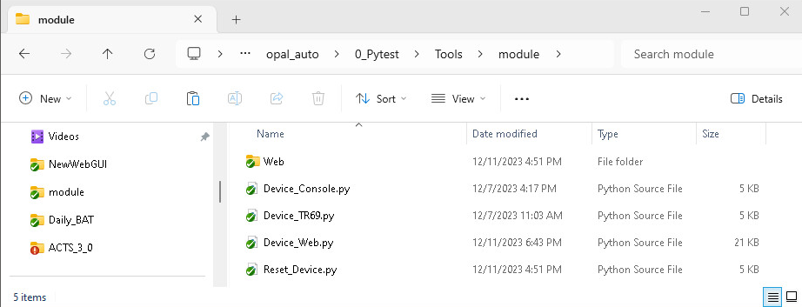
API Structure-In Custom Modules

Slide 4
In the script layer
import api.Console
import api.Misc as Misc
import api.TR as TR
#import module.CLI_funcs as CLI_funcs
import module.Device_Web as Device_Web
import module.Device_TR69 as Device_TR69
import module.Device_Console as Device_Console
@allure.feature(“Device GUI Example")
class TestGUI:
@allure.title('OPAL-8 Reset the device')
@allure.severity("CRITICAL")
def test_001(self):
objDeviceWeb = Device_Web.Device_Web("http://192.168.1.1", "EX5601")
objDeviceWeb.Web_Login("supervisor", "12345678")
objDeviceWeb.Setup_LAN("Default", ipv4_addr="192.168.10.30", ipv4_netmask="255.255.255.0")

Slide 5
In the script layer
import module.Device_Web as Device_Web
………………………………………………………………………………………………………………………..
@allure.title('OPAL-8 Reset the device')
@allure.severity("CRITICAL")
def test_001(self):
objDeviceWeb = Device_Web.Device_Web("http://192.168.1.1", "EX5601")
objDeviceWeb.Web_Login("supervisor", "12345678")
objDeviceWeb.Setup_LAN("Default", ipv4_addr="192.168.10.30", ipv4_netmask="255.255.255.0")
objDeviceWeb.Setup_WAN("ETHERNET", index="1", enable="yes", encapsulation="IPoE", MTU=1200)
Deveic_Web class
objDeviceWeb
__init__(…)
Web_Login(…)
Web_Click_Menu(…)
Web_Setup_LAN(…)
Web_Setup_WAN(…)

Slide 6
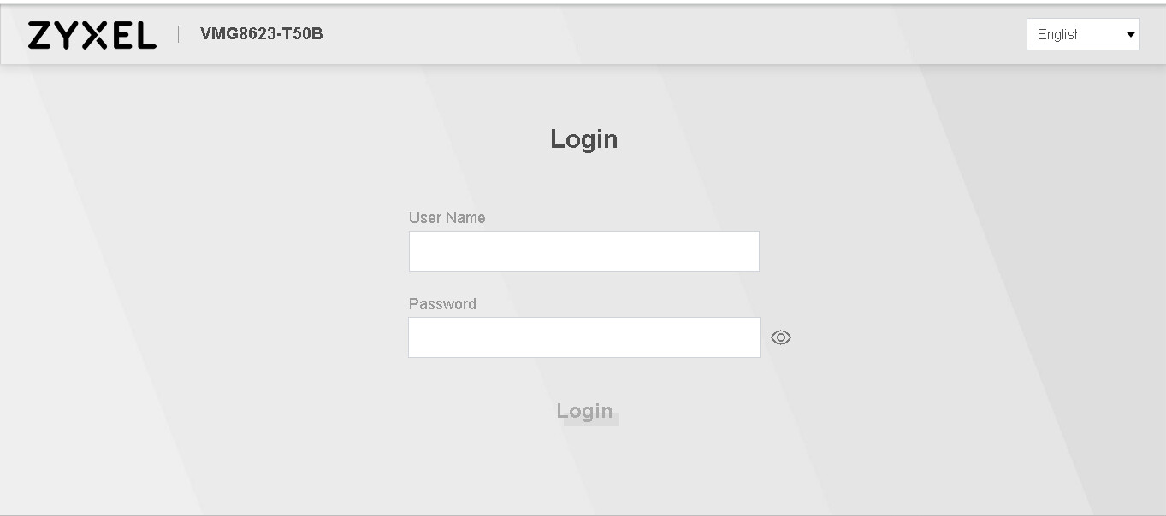
From the script to see the interface
Interface Layer
Deveic_Web class
objDeviceWeb
data members(attributes)
__init()__(…)
Web_Login(…)
Web_Click_Menu(…)
Web_Setup_LAN(…)
Web_Setup_WAN(…)

Slide 7
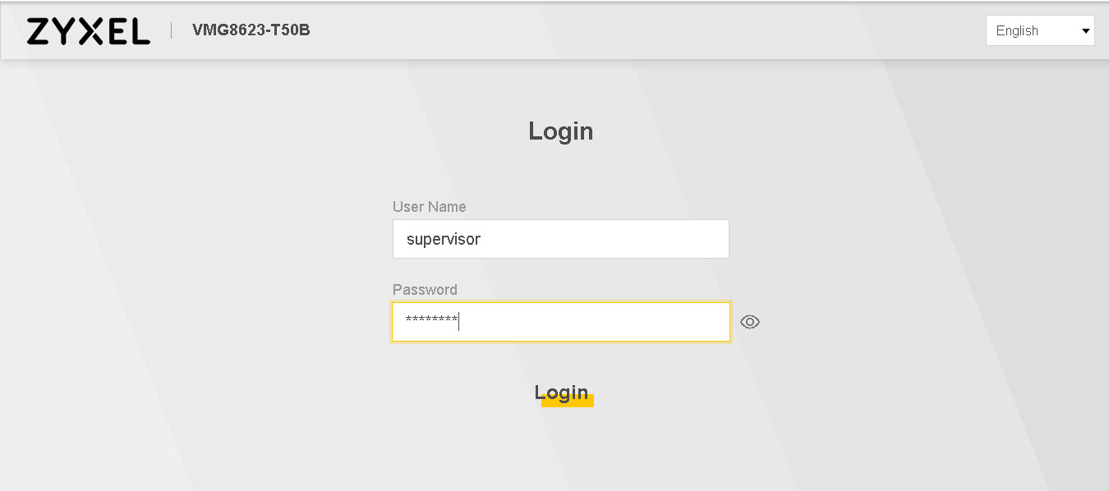
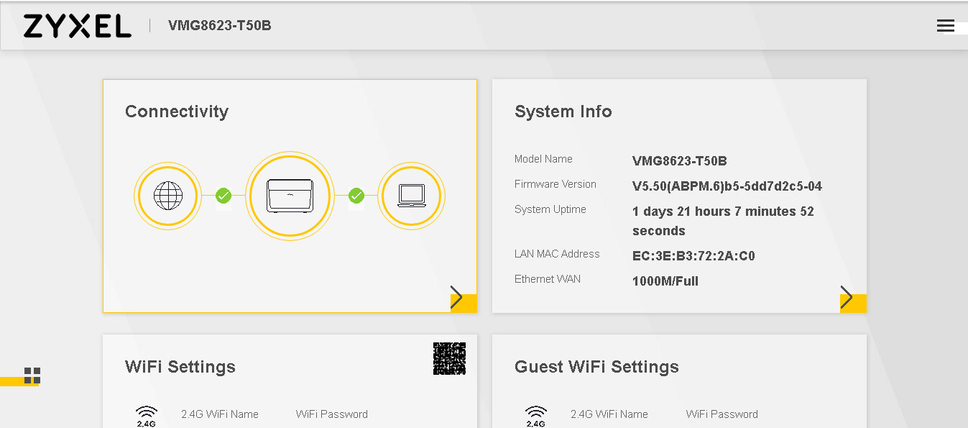
From the script to see the interface
Interface Layer
Deveic_Web class
objDeviceWeb
data members(attributes)
__init()__(…)
Web_Login(…)
Web_Click_Menu(…)
Web_Setup_LAN(…)
Web_Setup_WAN(…)

Slide 8
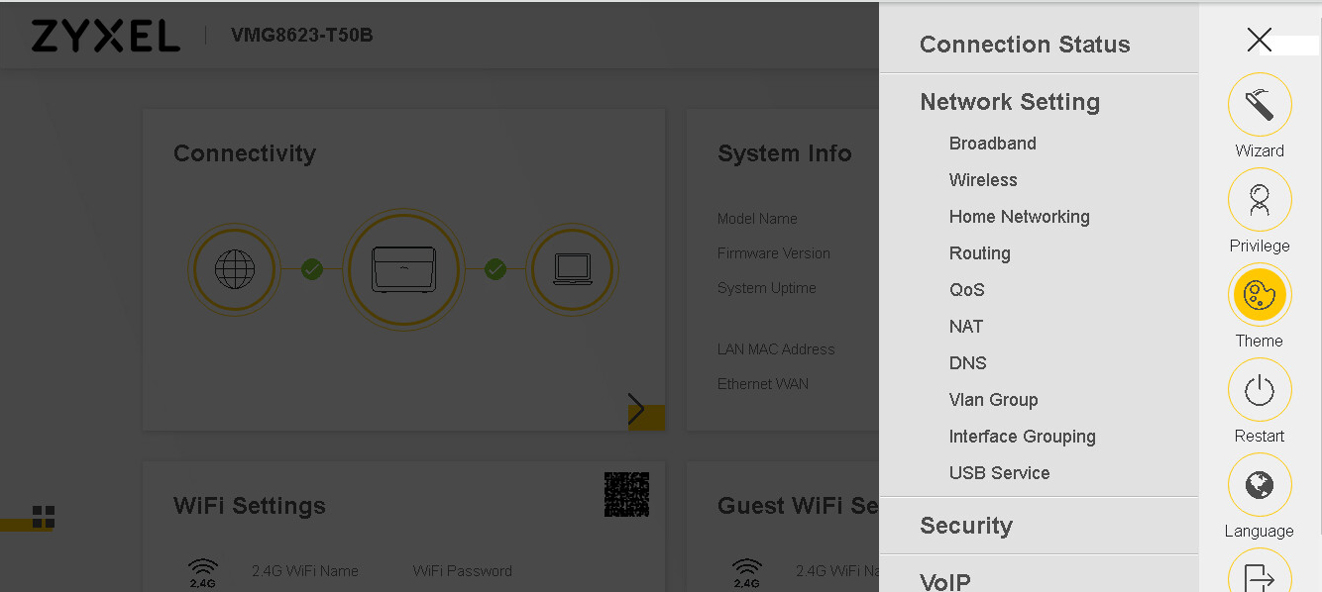
From the script to see the interface
Interface Layer
Deveic_Web class
objDeviceWeb
data members(attributes)
__init()__(…)
Web_Login(…)
Web_Click_Menu(…)
Web_Setup_LAN(…)
Web_Setup_WAN(…)

Slide 9
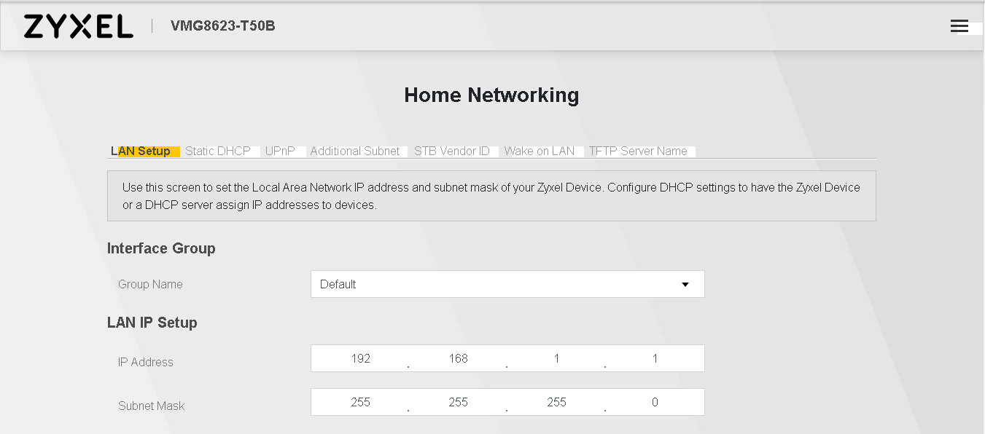
From the script to see the interface
Interface Layer
Deveic_Web class
objDeviceWeb
data members(attributes)
__init()__(…)
Web_Login(…)
Web_Click_Menu(…)
Web_Setup_LAN(…)
Web_Setup_WAN(…)

Slide 10
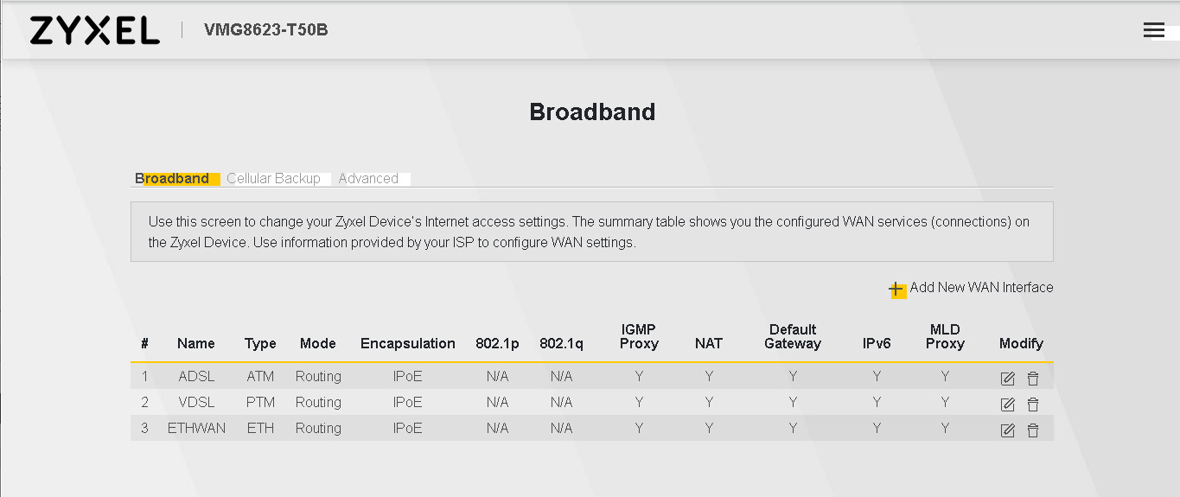
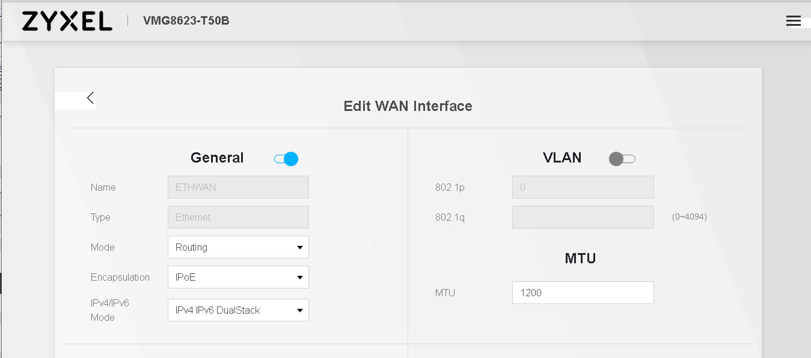
From the script to see the interface
Interface Layer
Deveic_Web class
objDeviceWeb
data members(attributes)
__init()__(…)
Web_Login(…)
Web_Click_Menu(…)
Web_Setup_LAN(…)
Web_Setup_WAN(…)

Slide 11
From the interface to see the process
Process Layer
Interface Layer
TIM_Web_Login class
AIS_Web_Login class
Deveic_Web class
(module/Device_Web)
__init()__(…)
__init()__(…)
Web_Login_Device()
Web_Login_Device()
data members(attributes)
obj_web_login
obj_web_menu
Web_Login class
__init()__(…)
__init()__(…)
Web_Login_Device()
Web_Login(…):
obj_web_login.Web_Login_Device(…)
Scripting Layer
@allure.severity("CRITICAL")
def test_001(self):
…………………………………………………………………….
objDeviceWeb.Web_Login(“supervisor", “12345678")

Slide 12
Web_Login_Device in the process layer
Process Layer
Web_Login class
__init()__(…)
Web_Login_Device()
def Web_Login_Device(self, user_name, password, lineNum=''):
WebApp.WebDrv_Set_Value("id", "username", user_name)
WebApp.WebDrv_Set_Value("id", "userpassword", password)
WebApp.WebDrv_Click("id", "loginBtn")
Misc.Wait(3)
WebApp.WebDrv_Wait_Device_Loading("xpath", ……)

Slide 13
Web_Click_Menu
Process Layer
Interface Layer
AIS_Web_Menu class
Deveic_Web class
(module/Device_Web)
__init()__(…)
Click_Menu()
data members(attributes)
obj_web_login
obj_web_menu
Web_Menu class
__init()__(…)
__init()__(…)
Click_Menu()
Web_Click_Menu(…) :
self.obj_menu.Click_Menu(…)
Scripting Layer
@allure.severity("CRITICAL")
def test_001(self):
…………………………………………………………………….
objDeviceWeb.Web_Click_Menu(“Network Setting", ..........)

Slide 14
Click_Menu in the process layer
Process Layer
Web_Login class
__init()__(…)
Click_Menu()
def Click_Menu(self, menu, sub_menu, tab_menu, lineNum=''):
WebApp.WebDrv_Click("id", "h_menu_list")
WebApp.WebDrv_Click("linkText", menu)
WebApp.WebDrv_Click("id", sub_menu)
WebApp.WebDrv_Click("id", tab_menu)

Slide 15
From the interface to see the process
Web_Menu class
Deveic_Web class
(module/Device_Web)
__init()__(…)
Click_Menu()
data members(attributes)
obj_web_menu
obj_setup_LAN
Web_Setup_LAN class
__init()__(…)
__init()__(…)
Setup_LAN (obj_menu, name, ipv4_addr,…)
Setup_LAN(name, ipv4_addr…)
Scripting Layer
@allure.severity("CRITICAL")
def test_001(self):
…………………………………………………………………….
objDeviceWeb.Setup_LAN("Default", ipv4_addr="192.168.10.30", ipv4_netmask="255.255.255.0")

Slide 16
Setup_LAN in the process layer
Process Layer
Web_Setup_LAN class
Scripting Layer
@allure.severity("CRITICAL")
def test_001(self):
…………………………………………………………………….
objDeviceWeb.Setup_LAN("Default", ipv4_addr="192.168.10.30", ipv4_netmask="255.255.255.0")
__init()__(…)
Setup_LAN()
def Setup_LAN(self, obj_nemu, name, ipv4_addr, ipv4_netmask,… lineNum=''):
obj_menu.Click_Menu("Network Setting", "Home_Networking", ………)
WebApp.WebDrv_List_Select("id", "ls_gp_select", "value", name)
if ipv4_addr != '':
ip_part = ipv4_addr.split('.')
WebApp.WebDrv_Set_Value("id", "a_ls_ip_value_1", ip_part[0])
…………………………………………………………………………………………………………
if dhcpd_state.lower() == 'enable':
WebApp.WebDrv_Click("id", "LANSetup_DHCP1")
……………………………………………………………………………………………….

Slide 17
Setup_LAN Arguments
def Setup_LAN(self,
name,
ipv4_addr=",
ipv4_netmask='',
dhcpd_state='',
dhcpd_begin_addr='',
dhcpd_end_addr='',
bf_auto_reserve='',
dhcp_relay_addr='',
dhcp_lstime_day='',
dhcp_lstime_hr='',
dhcp_lstime_min='',
dns_value='',
dns_server1_addr='',
dns_server2_addr='',
lineNum=''):
"""
# {name} : LAN interface name
……………………………………………………………………………………………………………….

Slide 18
Setup_LAN Arguments
def Setup_LAN(self,
name,
ipv4_addr=",
……………………………………………………….
……………………………………………………….
lineNum=''):
"""
# {name} : LAN interface name
# {ipv4_addr} : Interface IPv4 address
# {ipv4_netmask} : Interface IPv4 subnet mask
# {dhcpd_state} : {enable}, {disable}, {relay}. DHCP server state
# {dhcpd_begin_addr} : The DHCP server beginning IP dddress
# {dhcpd_end_addr} : The DHCP server ending IP Address
# {bf_auto_reserve} : {true}, {false} Auto reserve IP address for static IP
# {dhcp_relay_addr} : The DHCP relay IP Address
# {dhcp_lstime_day} : The DHCP lease time, day
# {dhcp_lstime_hr} : The DHCP lease time, hour
# {dhcp_lstime_min} : The DHCP lease time, minute
# {dns_value} : {dns_proxy}, {static}, {from_isp}
# {dns_server1_addr} : The IP address of the first DNS server, if dns_value is "static".
# {dns_server2_addr} : The IP address of the second DNS server, if dns_value is "static".

Slide 19
Web_Setup_WAN class and Setup_WAN method
Web_Setup_ETHER_WAN class
(module/web/Web_Setup_WAN.py)
Web_Setup_VDSL_WAN class
(module/web/Web_Setup_WAN.py)
Web_Setup_WAN class
(module/web/Web_Setup_WAN.py)
Web_Setup_ETHER_WAN
(Web_Setup_WAN)
Web_Setup_VDSL_WAN
(Web_Setup_WAN)
data members(attributes)
wan_type
__init()__(…)
__init()__(…)
__init()__(…)
Setup_WAN(…..):
………………………………
self.Add_New_Entry()
Setup_WAN(…..):
………………………..
self.Add_New_Entry()
Add_New_Entry():
pass
__init()__(…)
__init()__(…)
Setup_WAN(obj_menu,
index=‘1’,
name=‘’,
………..
MTU=‘’):
……………………………………
if index == “-1”:
self.Add_New_Entry(..)
Add_New_Entry():
…………………..
WebDrv_List_Select(…., "ETH")
Add_New_Entry():
…………………..
WebDrv_List_Select(…., “PTM")
Web_Setup_ADSL_WAN class
(module/web/Web_Setup_WAN.py)
Web_Setup_PON_WAN class
(module/web/Web_Setup_WAN.py)

Slide 20
Web_Setup_WAN class and Setup_WAN method
Interface Layer
Process Layer
Web_Setup_ETHER_WAN class
Web_Setup_VDSL_WAN class
Deveic_Web class
(module/Device_Web)
Web_Setup_WAN
Web_Setup_WAN
__init()__(…)
__init()__(…)
data members(attributes)
obj_web_menu
obj_setup_EtherWAN
obj_setup_VDSL
Setup_WAN(…..)
self.Add_New_Entry()
Setup_WAN(…..)
self.Add_New_Entry()
__init()__(…)
__init()__(…)
Add_New_Entry():
…………………..
WebDrv_List_Select(…., "ETH")
Add_New_Entry():
…………………..
WebDrv_List_Select(…., "ETH")
__init()__(…)
Setup_WAN(wan_type, index…)
if wan_type == “ETHERNET”
obj_setup_EtherWAN.Setup_WAN(….)
elif wan_type == “VDSL”
obj_setup_VDSL.Setup_WAN(….)
Scripting Layer
@allure.severity("CRITICAL")
def test_001(self):
…………………………………………………………………….
objDeviceWeb. Setup_WAN("ETHERNET", index=“-1", enable="yes", encapsulation="IPoE", MTU=1200)

Slide 21
Setup_WAN Arguments
def Setup_WAN(self,
wan_type,
bf_delete='',
index="1",
name='',
enable='',
atm_vpi='',
atm_vci='',
encapsulation='',
user_name='',
password='',
conntrigger='',
timeout='',
passthrough='',
ipv4_address='',
ipv4_netmask='',
ipv4_default_gw='',
vlan_id='',
primary_DNS='',
secondary_DNS='',
apply_as_default_gateway='',
enableIGMP_proxy='',
nat_enable='',
MTU='',
lineNum=''):
……………………………………………………………………………………………………………….

Slide 22
Setup_LAN Arguments
{wan_type} : "ETHERNET", "VDSL", "ADSL", "PON"
{bf_delete} : True, False, to delete (or not) the entry which be specificed by {index}
{index} : -1, to add a new DNS entry. or 1, 2, 3, ...n to edit or delete nth entry
{name} : Interface name
{enable} : "yes", "no". Enable/Disable the interface
{atm_vpi} : 0 ~ 255
{atm_vci} : 32 ~ 65535
{encapsulation} : "IPoE", "PPPoE"
{user_name} : The PPPoE user name
{password} : The PPPoE password
{conntrigger} : "AutoConnect", "OnDemand". The PPPoE connection is "Always connected" or "Dial on demand"
{timeout} : PPPoE idle time-out value, seconds. The PPPoE connection must "Dial on demand". conntrigger='OnDemand'
{passthrough} : {yes}, {no}. PPPoE passthrough
{ipv4_address} : Interface static IPv4 address. "0.0.0.0" means obtain an IP Address Automatically
{ipv4_netmask} : Interface IPv4 subnet mask
{ipv4_default_gw} : Default gateway IPv4 address
{vlan_id} : "0" ~ "4094". VLAN ID of the interface. "-1" means disable VLAN
{primary_DNS} : Primary DNS server IPv4 address. "0.0.0.0" means obtain the DNS server Address Automatically
{secondary_DNS} : Secondary DNS server IPv4 address. "0.0.0.0" means obtain the DNS server Address Automatically
{apply_as_default_gateway} : "yes", "no". Setup that the WAN interface is connect to the default gateway.
{enableIGMP_proxy} : "yes", "no"
{nat_enable} : "yes", "no"
{MTU} : An integer, Max Transfer Unit

Slide 23
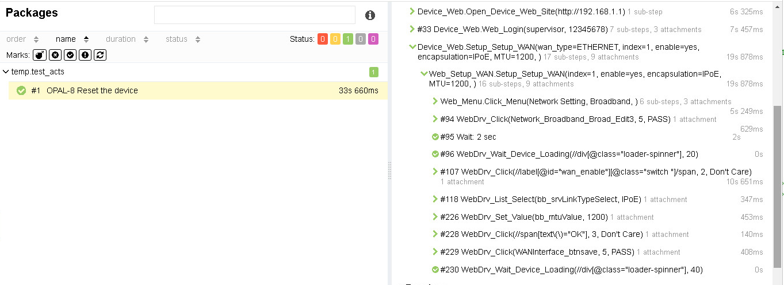
@allure.title('OPAL-8 Reset the device')
@allure.severity("CRITICAL")
def test_001(self):
objDeviceWeb = Device_Web.Device_Web("http://192.168.1.1", "EX5601")
objDeviceWeb.Web_Login("supervisor", "12345678")
objDeviceWeb.Setup_WAN("ETHERNET", index="1", enable="yes", encapsulation="IPoE", MTU=1200)

Slide 24
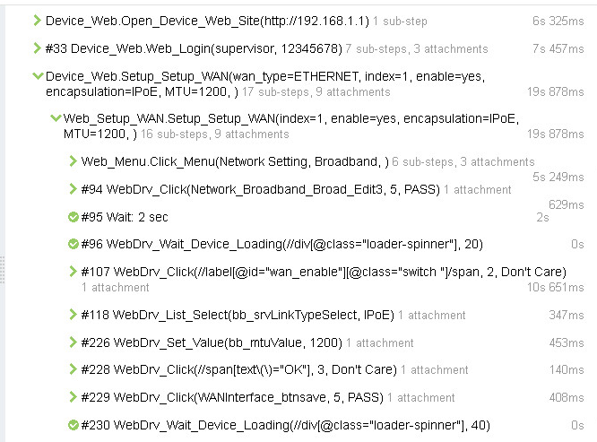
Setup_WAN Function
stepTitle = lineNum + "Device_Web.Setup_Setup_WAN(“
all_args = locals()
for key, value in all_args.items():
if key != "self" and key != "lineNum":
value = str(value)
if len(value) > 0:
stepTitle = stepTitle + key + "=" + value + ", "
stepTitle = stepTitle + ")"
with allure.step(stepTitle):
if wan_type == "ETHERNET:
……………………………………………………………………………………………………………………….
self.obj_setup_EtherWAN = Web_Setup_WAN.Web_Setup_ETHER_WAN()
self.obj_setup_EtherWAN.Setup_WAN(self.obj_menu, bf_delete, index, ………)
elif wan_type == "VDSL":
………………………………………………………………………………………………………………………
self.obj_setup_VDSL_WAN = Web_Setup_WAN.Web_Setup_VDSL_WAN()
self.obj_setup_VDSL_WAN.Setup_WAN(self.obj_menu, bf_delete, index, …….)
objDeviceWeb.Setup_WAN("ETHERNET", index="1", enable="yes", encapsulation="IPoE", MTU=1200)

Slide 25
Setup_WAN Function
stepTitle = lineNum + "Device_Web.Setup_Setup_WAN(“
all_args = locals()
for key, value in all_args.items():
if key != "self" and key != "lineNum":
value = str(value)
if len(value) > 0:
stepTitle = stepTitle + key + "=" + value + ", "
stepTitle = stepTitle + ")"
with allure.step(stepTitle):
if wan_type == "ETHERNET:
……………………………………………………………………………………………………………………….
self.obj_setup_EtherWAN = Web_Setup_WAN.Web_Setup_ETHER_WAN()
self.obj_setup_EtherWAN.Setup_WAN(self.obj_menu, bf_delete, index, ………)
elif wan_type == "VDSL":
………………………………………………………………………………………………………………………
self.obj_setup_VDSL_WAN = Web_Setup_WAN.Web_Setup_VDSL_WAN()
self.obj_setup_VDSL_WAN.Setup_WAN(self.obj_menu, bf_delete, index, …….)
objDeviceWeb.Setup_WAN("ETHERNET", index="1", enable="yes", encapsulation="IPoE", MTU=1200)

Slide 26
Setup_WAN function
with allure.step(stepTitle):
obj_menu.Click_Menu("Network Setting", "Broadband")
if index == "-1":
self.Add_New_Entry(name)
else:
edit_btn = self.wan_btn[index]
WebApp.WebDrv_Click("id", edit_btn, 5)
Misc.Wait(2)
WebApp.WebDrv_Wait_Device_Loading("xpath", "//div[@class=\"loader-spinner\"]")
if enable.lower() == "yes":
WebApp.WebDrv_Click("xpath", '//label[@id=\"wan_enable\"][@class=\"switch \"]/span', 2, "Don't Care")
elif enable.lower() == "no":
WebApp.WebDrv_Click("xpath", '//label[@id=\"wan_enable\"][@class=\"switch active \"]/span', 2, "Don't Care")
if str(atm_vpi).isdigit():
WebApp.WebDrv_Set_Value("id", "bb_vpi", str(atm_vpi))
if str(atm_vci).isdigit():
WebApp.WebDrv_Set_Value("id", "bb_vci", str(atm_vci))

Slide 27
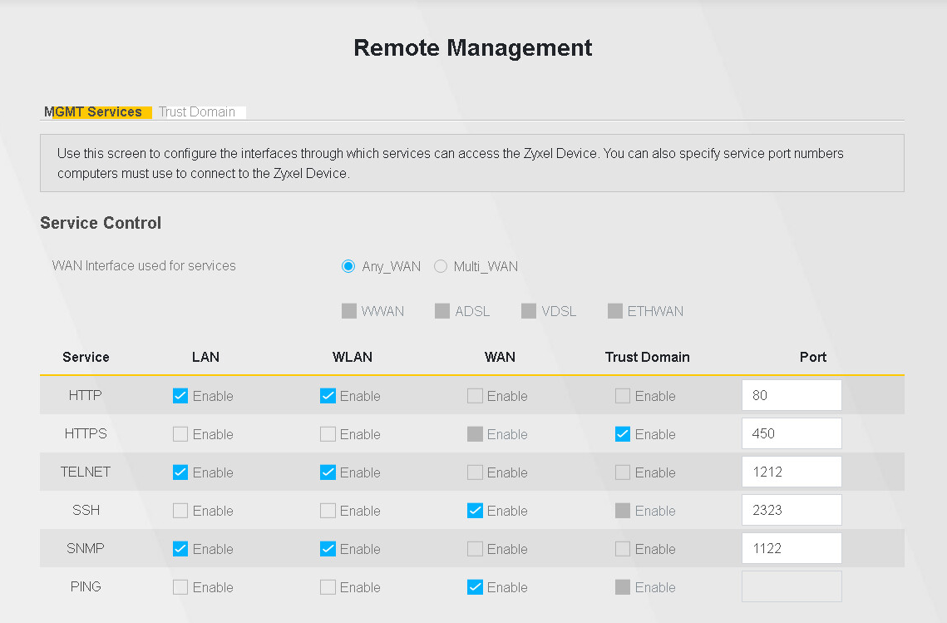
Setup_ReMgmt function
Scripting Layer
@allure.severity("CRITICAL")
def test_001(self):
…………………………………………………………………….
objDeviceWeb.Setup_ReMgmt(https_matrix=“-LAN-WLAN+WAN", https_port=“450“, ssh_port=“2323)

Slide 28
Setup_ReMgmt Arguments
def Setup_ReMgmt(self,
http_matrix='',
https_matrix='',
ftp_matrix='',
telnet_matrix='',
ssh_matrix='',
snmp_matrix='',
ping_matrix='',
http_port='',
https_port='',
ftp_port='',
telnet_port='',
ssh_port='',
snmp_port='',
no_save='yes',
lineNum=''):
"""
## {http_matrix} : "+LAN", "-LAN", "+WAN", "-WAN", "+TrustDomain", "-TrustDomain"
## {https_matrix} : "+LAN", "-LAN", "+WAN", "-WAN", "+TrustDomain", "-TrustDomain"
………………………………………………………………………………………………………………………………………….
"""

Slide 29
Setup_ReMgmt Arguments
"""
## {http_matrix} : "+LAN", "-LAN", "+WAN", "-WAN", "+TrustDomain", "-TrustDomain"
## {https_matrix} : "+LAN", "-LAN", "+WAN", "-WAN", "+TrustDomain", "-TrustDomain"
## {ftp_matrix} : "+LAN", "-LAN", "+WAN", "-WAN", "+TrustDomain", "-TrustDomain"
## {telnet_matrix} : "+LAN", "-LAN", "+WAN", "-WAN", "+TrustDomain", "-TrustDomain"
## {ssh_matrix} : "+LAN", "-LAN", "+WAN", "-WAN", "+TrustDomain", "-TrustDomain"
## {snmp_matrix} : "+LAN", "-LAN", "+WAN", "-WAN", "+TrustDomain", "-TrustDomain"
## {ping_matrix} : "+LAN", "-LAN", "+WAN", "-WAN", "+TrustDomain", "-TrustDomain"
## {http_port} : "n"
## {https_port} : "n"
## {ftp_port} : "n"
## {telnet_port} : "n"
## {ssh_port} : "n"
## {snmp_port} : "n"
"""

Slide 30
Different Remote Management Matrix

Slide 31
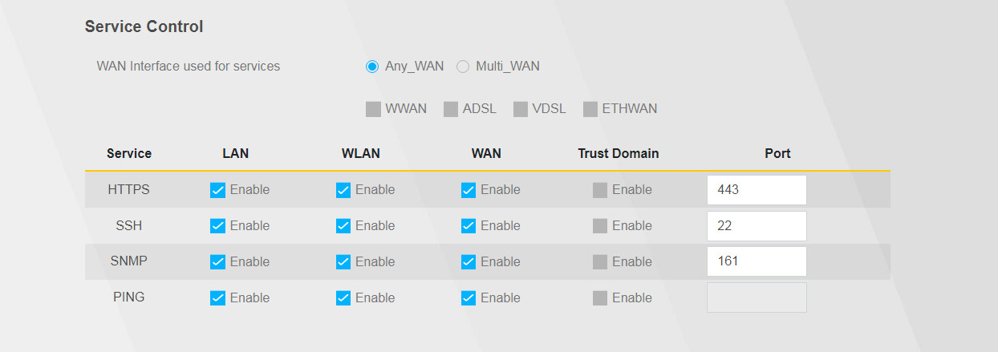
Different Remote Management Matrix

Slide 32
Different Remote Management Matrix
id = “httpsLan_id_0
id = “httpsLan_id_0_label
id = “httpsLan_id_1
id = “httpsLan_id_1_label

Slide 33
Different Remote Management Matrix
id = “httpsLan_id_0
id = “httpsLan_id_0_label
id = “httpsLan_id_1
id = “httpsLan_id_1_label

Slide 34
Different Remote Management Matrix
In the device’s variable file
“$remote_http_index”: “0”,
“$remote_https_index”: “1”,
“$remote_ftp_index”: “None”,
“$remote_telnet_index”: “2”,
“$remote_ssh_index”: “3”,
“$remote_snmp_index”: “4”,
“$remote_ping_index”: “5”,
id = “httpsLan_id_0
id = “httpsLan_id_0_label
id = “httpsLan_id_1
id = “httpsLan_id_1_label

Slide 35
Different Remote Management Matrix
In the device’s variable file
“$remote_http_index”: “None”,
“$remote_https_index”: “0”,
“$remote_ftp_index”: “None”,
“$remote_telnet_index”: “None”,
“$remote_ssh_index”: “1”,
“$remote_snmp_index”: “2”,
“$remote_ping_index”: “3”,
id = “httpsLan_id_0
id = “httpsLan_id_0_label
id = “httpsLan_id_1
id = “httpsLan_id_1_label

Slide 36
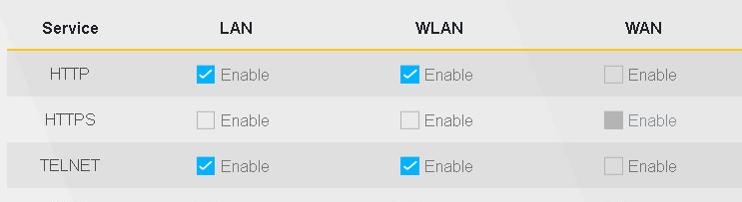
class Web_Setup_ReMgmt:
def __init__(self, lineNum=''):
self.REMGMT_HTTP_INDEX = VAR("$remote_http_index")
self.REMGMT_HTTPS_INDEX = VAR("$remote_https_index")
self.REMGMT_FTP_INDEX = VAR("$remote_ftp_index")
self.REMGMT_TELNET_INDEX = VAR("$remote_telnet_index")
self.REMGMT_SSH_INDEX = VAR("$remote_ssh_index")
self.REMGMT_SNMP_INDEX = VAR("$remote_snmp_index")
self.REMGMT_PING_INDEX = VAR("$remote_ping_index")
class Web_Setup_ReMgmt:
def Click_Service(self, service_name, matrix, lineNum=''):
if service_name == "HTTP":
target_index = self.REMGMT_HTTP_INDEX
elif service_name == "HTTPS":
target_index = self.REMGMT_HTTPS_INDEX
………………………………………………………………………………………………………..
# Access from LAN
expected_value = None
if "+LAN" in matrix:
expected_value = True
elif "-LAN" in matrix:
expected_value = False
Click_Serveic(…)
checks and clicks a row

Slide 37
Different Remote Management Matrix
def Click_Service(self, service_name, matrix, lineNum=''):
if service_name == "HTTP":
target_index = self.REMGMT_HTTP_INDEX
elif service_name == "HTTPS":
target_index = self.REMGMT_HTTPS_INDEX
…………
# Access from LAN ################################
expected_value = None
if "+LAN" in matrix:
expected_value = True
elif "-LAN" in matrix:
expected_value = False
if expected_value is not None:
target_id = "httpsLan_id_" + target_index
WebApp.WebDrv_Is_Selected("id", target_id, 10, variable_name="bfChecked")
target_value = VAR("bfChecked")
if expected_value is not target_value:
target_click_id = target_id + "_label"
WebApp.WebDrv_Click("id", target_click_id, 5)
# Access from WLAN ################################################
expected_value = None
if "+WLAN" in matrix:
id = “httpsLan_id_0
id = “httpsLan_id_0_label

Slide 38
Setup_ReMgmt function
def Setup_ReMgmt(self,……):
……………………………………………………………………………………………..
with allure.step(stepTitle):
…………………………………………………………………………………………
# Check to find an element in Remote Management page
## HTTP Service ############################################
if len(http_matrix) > 0 and self.REMGMT_HTTP_INDEX.isdigit():
self.Click_Service("HTTP", http_matrix)
if len(http_port) > 0 and http_port.isdigit and self.REMGMT_HTTP_INDEX.isdigit():
elm_id = "port_" + self.REMGMT_HTTP_INDEX
WebApp.WebDrv_Set_Value("id", elm_id, http_port)
### HTTPS Servic ###############################################
if len(https_matrix) > 0 and self.REMGMT_HTTPS_INDEX.isdigit():
self.Click_Service("HTTPS", https_matrix)
if len(https_port) > 0 and https_port.isdigit and self.REMGMT_HTTPS_INDEX.isdigit():
elm_id = "port_" + self.REMGMT_HTTPS_INDEX
WebApp.WebDrv_Set_Value("id", elm_id, https_port)
### FTP Service #########################################
@allure.severity("CRITICAL")
def test_001(self):
objDeviceWeb.Setup_ReMgmt(https_matrix=“-LAN-WLAN+WAN",
https_port=“450“, ssh_port=“2323)

